Slide 1
Localization of Transmitter using TDOA analysis Mid Term Report
Supervisor – Prof. Seshan Srirangarajan
By -
Divyansh Kumar and Gopal Saha

Slide 2
Why Localize Transmitter ?
Defence – Tracking Enemy Radars and Drones
UAV Tracking - Detects unauthorized or enemy UAVs by pinpointing their source location
Mobile Terminal Positioning - Provides accurate position for mobile users even in environments where traditional GPS is unreliable
Medical Tracking - Localizing transmitter-equipped medical devices to track patients and belongings

Slide 3
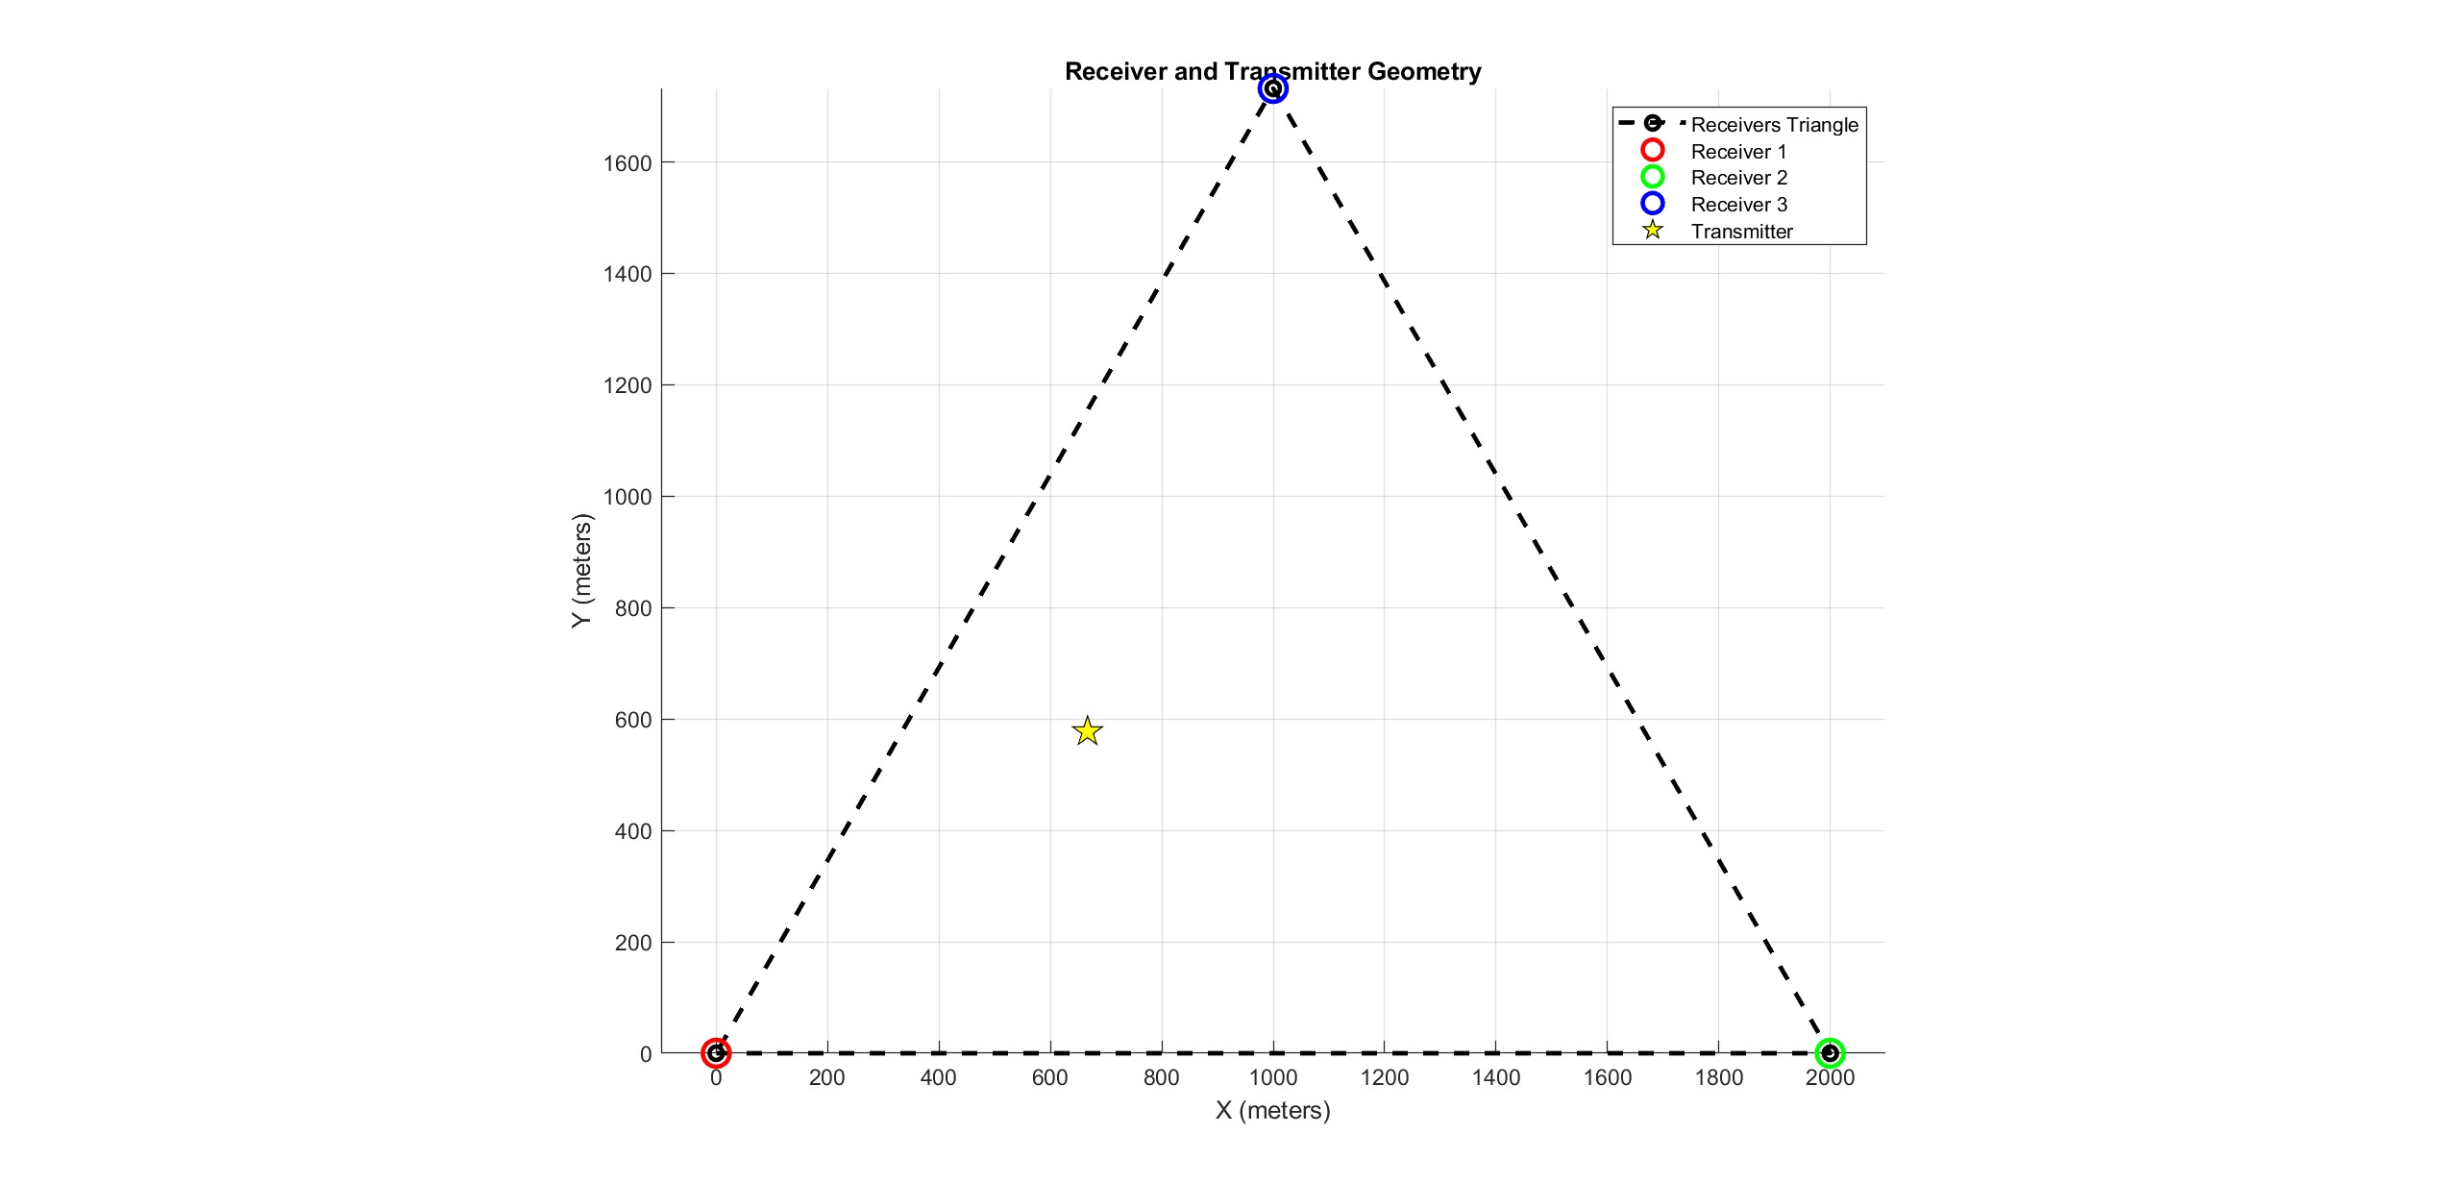
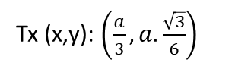
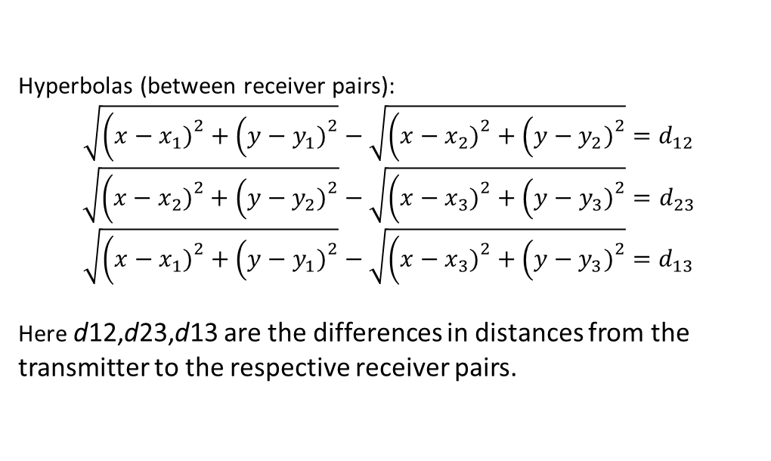
What is TDOA ?
TDOA stands for Time difference of Arrival. Its one of the methods to pinpoint transmitter location
Hyperbolic Multilateration : Each pair of Receiver defines a Hyperbola in 2D (hyperboloid in 3D). [1]
For example Lets Take 3 Receivers forming a triangle and 1 transmitter in 2D plane. Coordinates of R1,R2,R3 are (0,0), (a,0), ($\frac{a}{2},a.\frac{\sqrt{3}}{2})$
Tx (x,y): $\left(\frac{a}{3},a.\frac{\sqrt{3}}{6}\right)$
Hyperbolas (between receiver pairs):
$$\sqrt{\left(x−x_{1}{\left.)\right.}^{2}+\left(y−y_{1}{\left.)\right.}^{2}\right.\right.}−\sqrt{\left(x−x_{2}{\left.)\right.}^{2}+\left(y−y_{2}{\left.)\right.}^{2}\right.\right.}=d_{12}$$
$$\sqrt{\left(x−x_{2}{\left.)\right.}^{2}+\left(y−y_{2}{\left.)\right.}^{2}\right.\right.}−\sqrt{\left(x−x_{3}{\left.)\right.}^{2}+\left(y−y_{3}{\left.)\right.}^{2}\right.\right.}=d_{23}$$
$$\sqrt{\left(x−x_{1}{\left.)\right.}^{2}+\left(y−y_{1}{\left.)\right.}^{2}\right.\right.}−\sqrt{\left(x−x_{3}{\left.)\right.}^{2}+\left(y−y_{3}{\left.)\right.}^{2}\right.\right.}=d_{13}$$
Here d12,d23,d13 are the differences in distances from the transmitter to the respective receiver pairs.

Slide 4
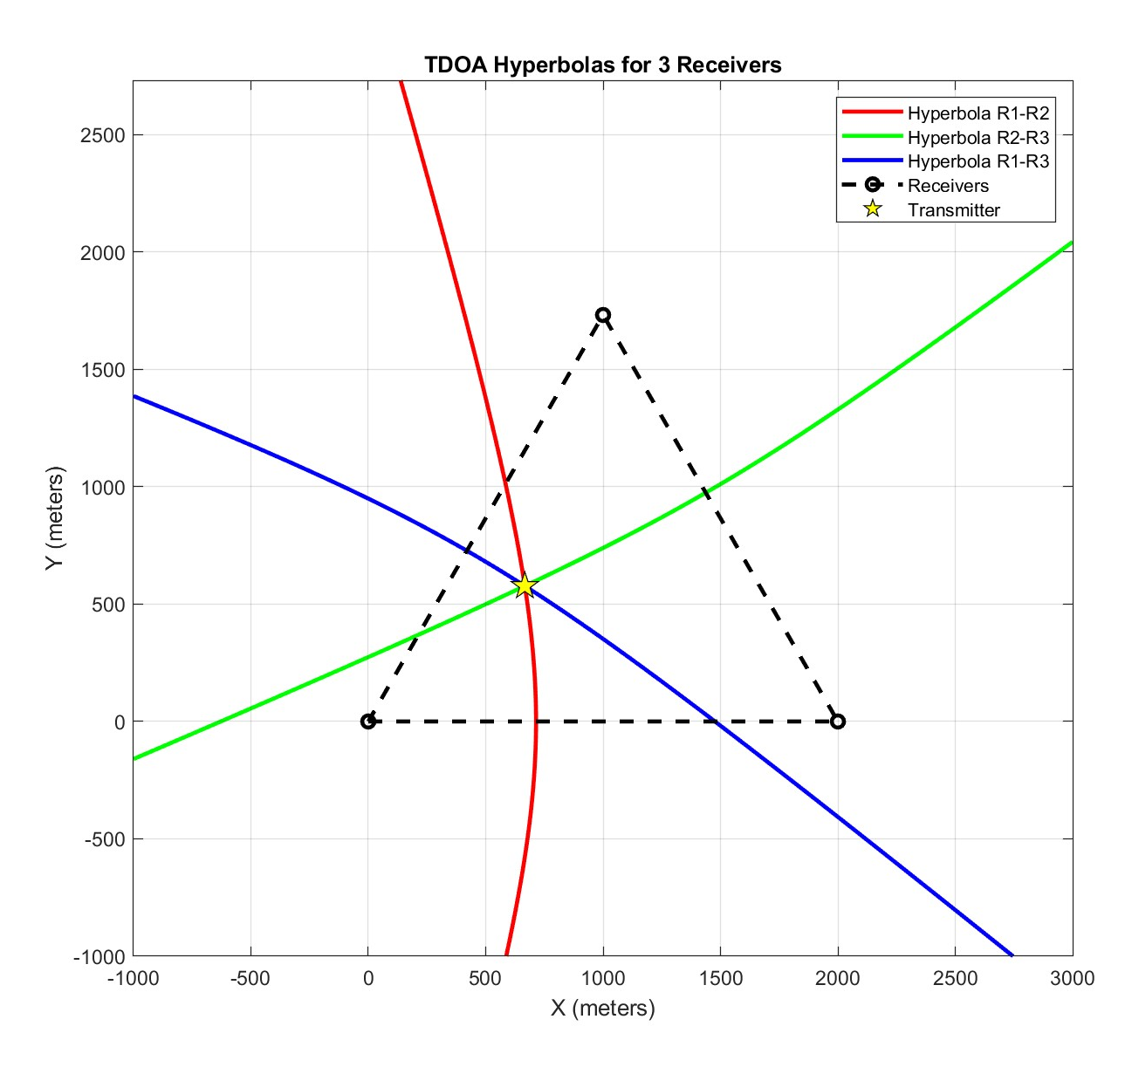
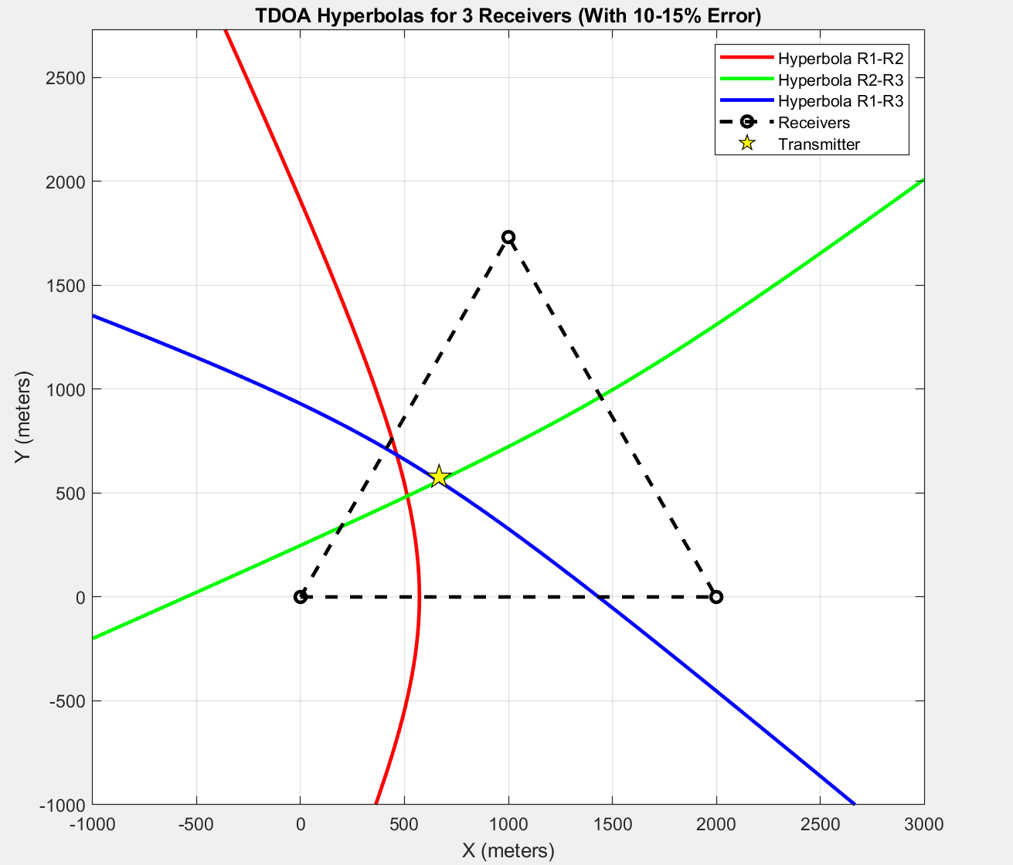

These Distances can be found using Receiver Information
$$d_{ij}=c×\left(T_{i}−T_{j}\right)$$
Time Delay calculated via cross correlation of time signals received
by both receivers (signal processing part!)
In Simulation we have assumed we know the Receiver information and have calculated dij
Accuracy Depends on how accurately we calculate dij !
Figure Below shows 10-15% Error in calculation of dij

Slide 5
Objectives!
Learn Basics of RTL-SDRs, HackRF one, GNU Radio Companion
Transmitter and Receiver Placement and circuit simulation
Synchronization among receivers
TDOA Calculation and Position Estimation via Visualization
Data Handling and Cross Correlation

Slide 6
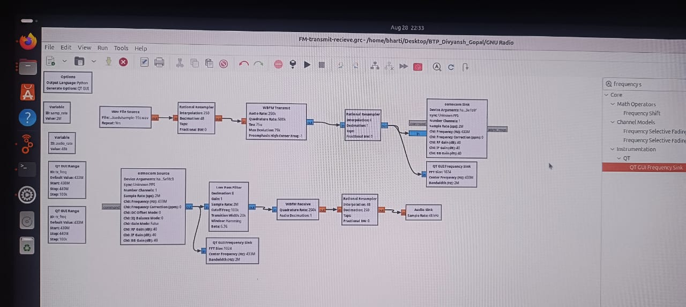
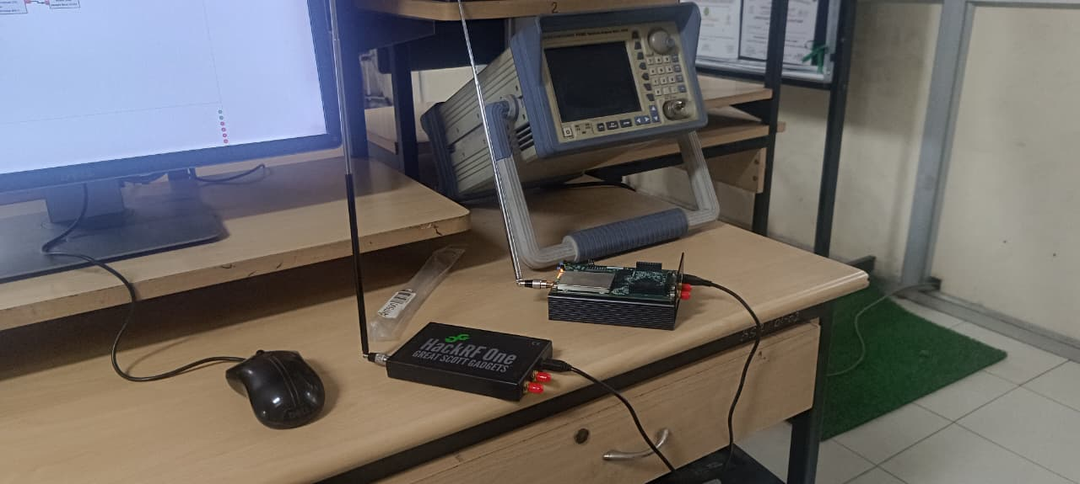
Learn Basics of RTL-SDRs, HackRF one, GNU Radio Companion
We Started by creating a transmitter and receiver circuit, transmitted a WAV file using FM modulation
Rx
Tx
Sample Rate – 2MHz
Channel Frequency – 433MHz
Audio Rate – 48KHz

Slide 7
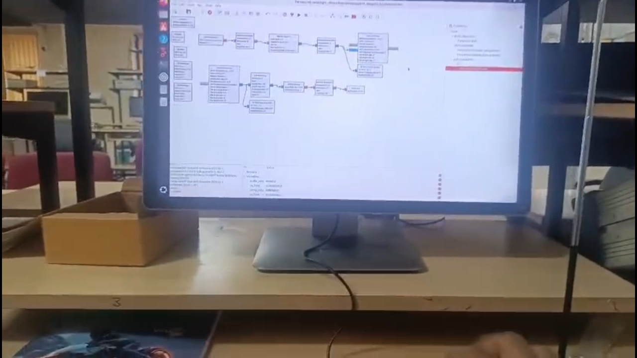
Demo

Slide 8
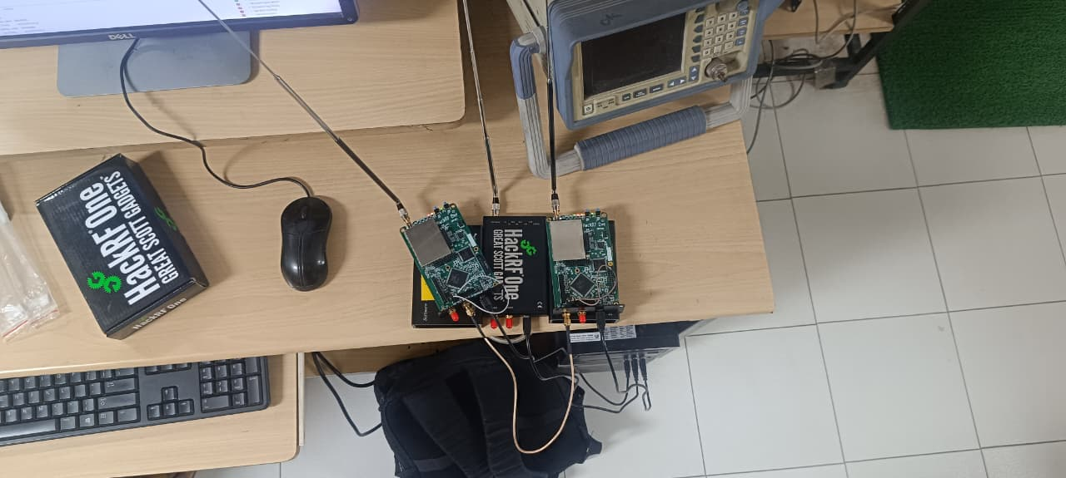
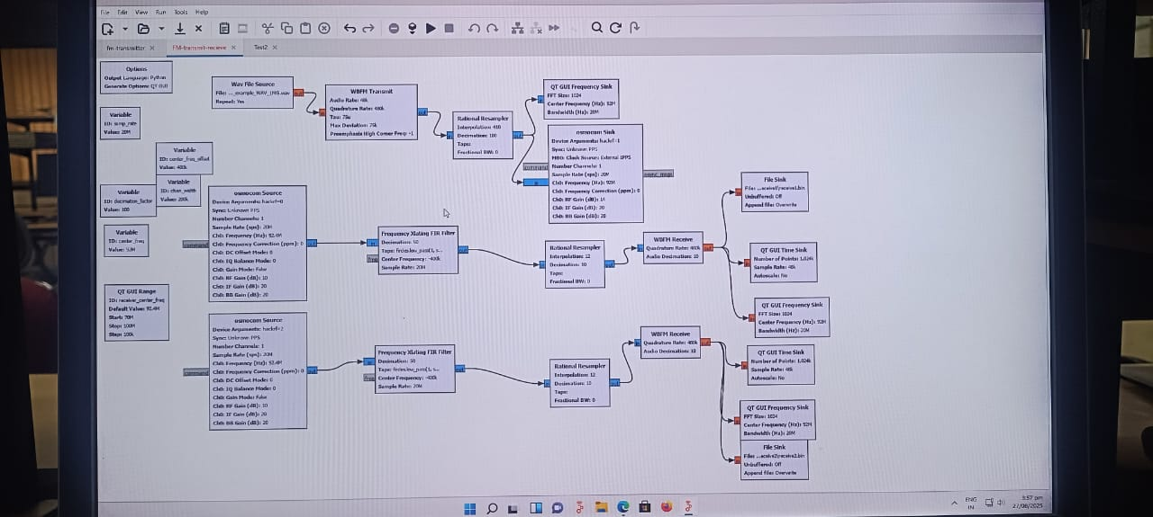
Transmitter and Receiver Placement and circuit simulation
Equipments Used
3x HackRF one (2 Rx and 1 Tx)
1 SMA splitter cable
3x Antennas
For Synchronization we used SMA Cable to connect master CLCKOUT of HackRF 1 to CLCKIN of HackRF 2, and connected Trigger buttons so that they start sampling at the same time. [4]

Slide 9
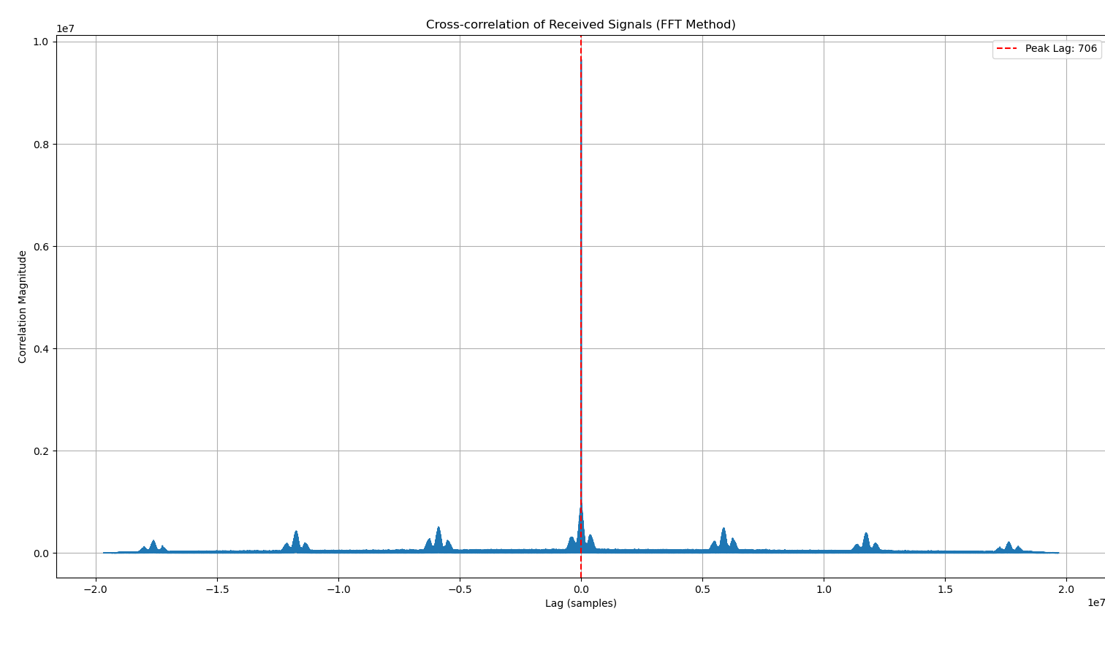
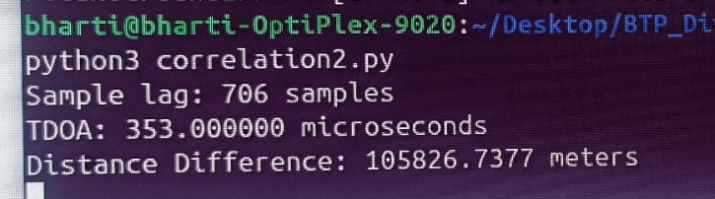
Result
Ran a Python Script that does cross correlation in the frequency domain using Fast Fourier Transform (FFT).
Cross- correlation Theorem – correlation in time domain is equivalent to a multiplication in the frequency domain
Our Script calculates time difference of arrival
Actual Distance 0.2 meters From calculation we get 105,826 meters

Slide 10
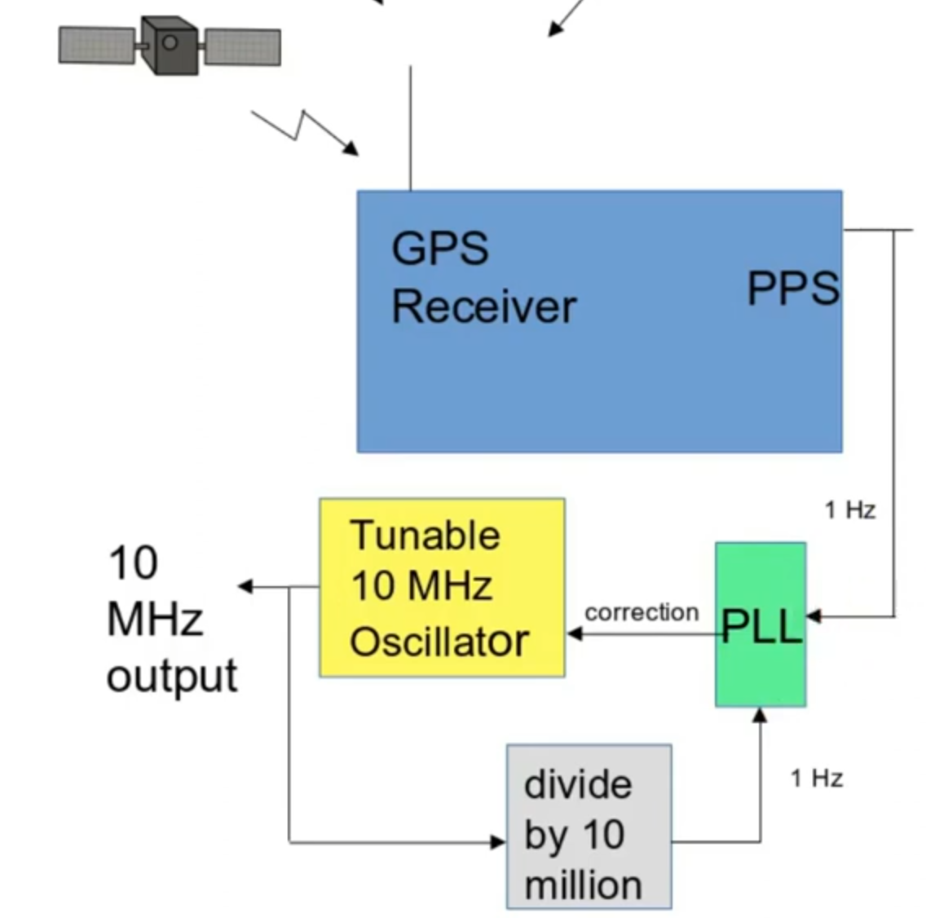
Synchronization, And Optimal Device Placement
Clock in Clock out Method is not feasible as
Receivers need to be close
The SMA splitter cable induces phase delay
Achievable Resolution for delay measurement
10MHz sampling => 100ns . 3 . 1e8 = 30m
2GHz sampling => 0.5ns . 3 . 1e8 = 0.15m (good for lab experiment!)
Each sample corresponds to 30 meters of range difference for 10MHz sampling and 15cm of range difference for 2GHz sampling. This is the limiting factor for TDOA-based localization accuracy. Can't provide external clock in GHz as HackRF CLKIN only accepts 10 MHz signals (3.3V square wave).
We need to perform this at a bigger scale since we can’t use GHz clocks
After searching online we found a solution, using GPS clocks!
GPSDO is the best option.
Provides <20ns synchronization accuracy between sites
Given Order of 3x GPSDO and 3x Raspberry Pi.

Slide 11
Future Agenda
Synchronize Receivers using GPSDO at 10MHz. Distributed Installation of Receivers across the campus
Use Raspberry pi as a mini computer to collect the information via receivers and send it to master PC via campus
Network
Using Matlab Perform Cross correlation of these received signals and calculate the Time Difference of Arrival.
Generate Hyperbolas and localize the transmitter

Slide 12
References
Object Tracking Using Time Difference of Arrival (TDOA) - MATLAB & Simulink [1]
Software Defined Radio with HackRF, Lesson 1 - Great Scott Gadgets [2]
TDOA Transmitter Localization with RTL-SDRs - Panoradio SDR [3]
Combining two HackRF SDR to see more – Oleg Kutkov personal blog [4]
https://www.mdpi.com/1424-8220/18/11/4073/pdf?version=1542876960 [5]
https://www.mdpi.com/1424-8220/23/1/507/pdf?version=1672910374 [6]
https://ieeexplore.ieee.org/stamp/stamp.jsp?tp=&arnumber=7497354 [7]

Slide 13
Thank You

